Slide 1
Public Transport & Housing Sale Trends
in Metropolitan Melbourne
Project 1 – Group 1
Date : 19/10/2023
Team Members
Abhidnya
Talieh
Peter
Yared

Slide 2
Aim :
To analyse the share of the different public transport modes and study the correlation between the passenger footfall for the metro & the housing sale data for the year 2018-23 in Melbourne Metropolitan
Data Source:
Passenger footfall data -
by Public Transport Victoria (PTV)
Housing sale data – Land Victoria
Victorian Integrated Survey of Travel and Activity (VISTA) –
by department of Transport & Planning

Slide 3
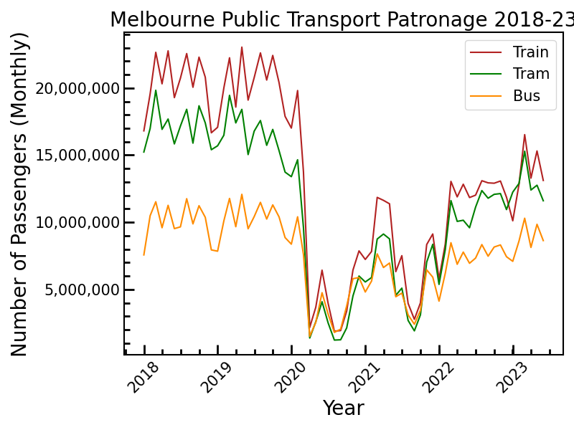
Share of different modes of Public Transport in Melbourne

Slide 4
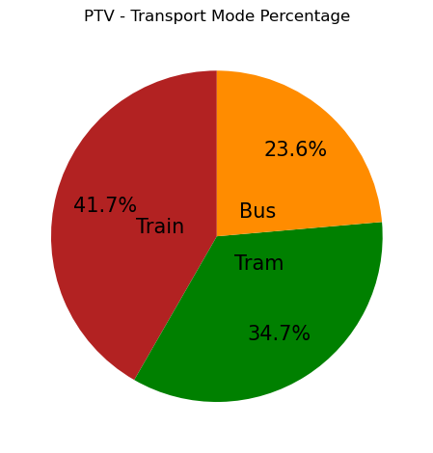
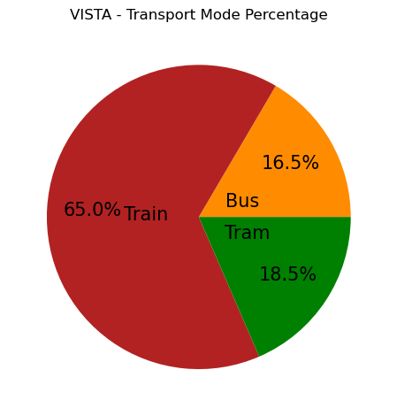
Mode of Transport – Comparison with VISTA Survey

Slide 5
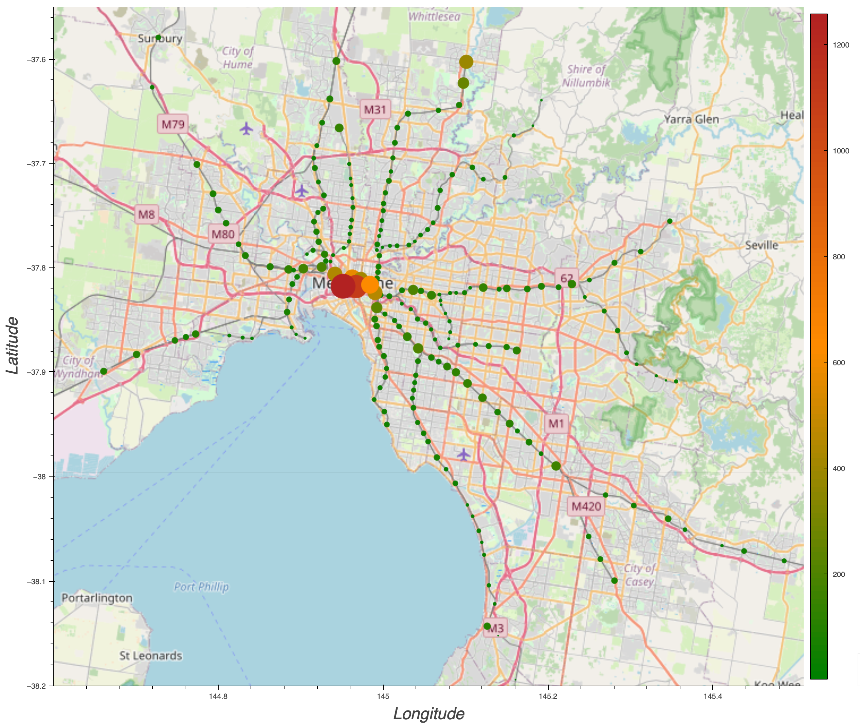
Melbourne Metro Station Map by total weekday footfall 2018-23

Slide 6
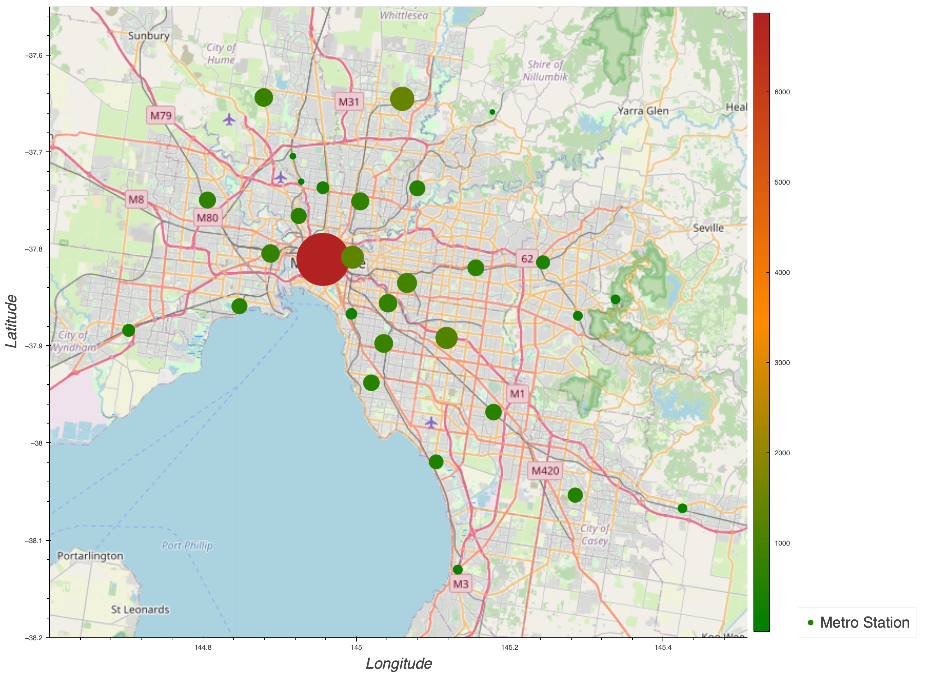
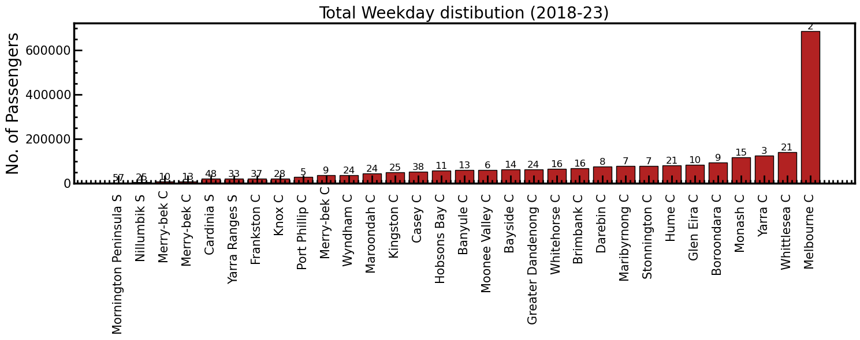
Melbourne City Council Map by total weekday footfall18-23

Slide 7
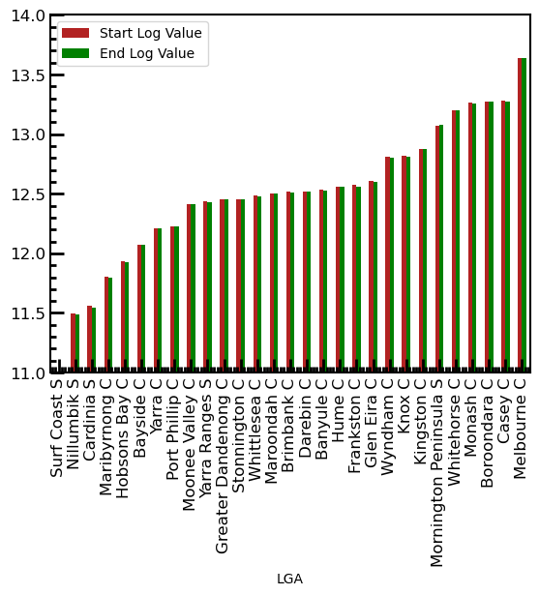
Metro Trains Starting and Ending by City Councils

Slide 8
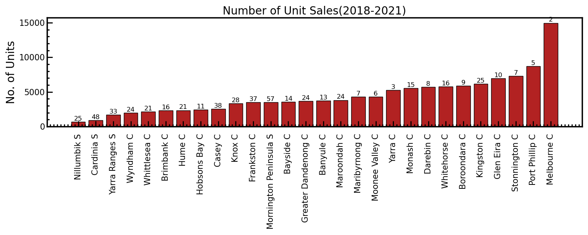
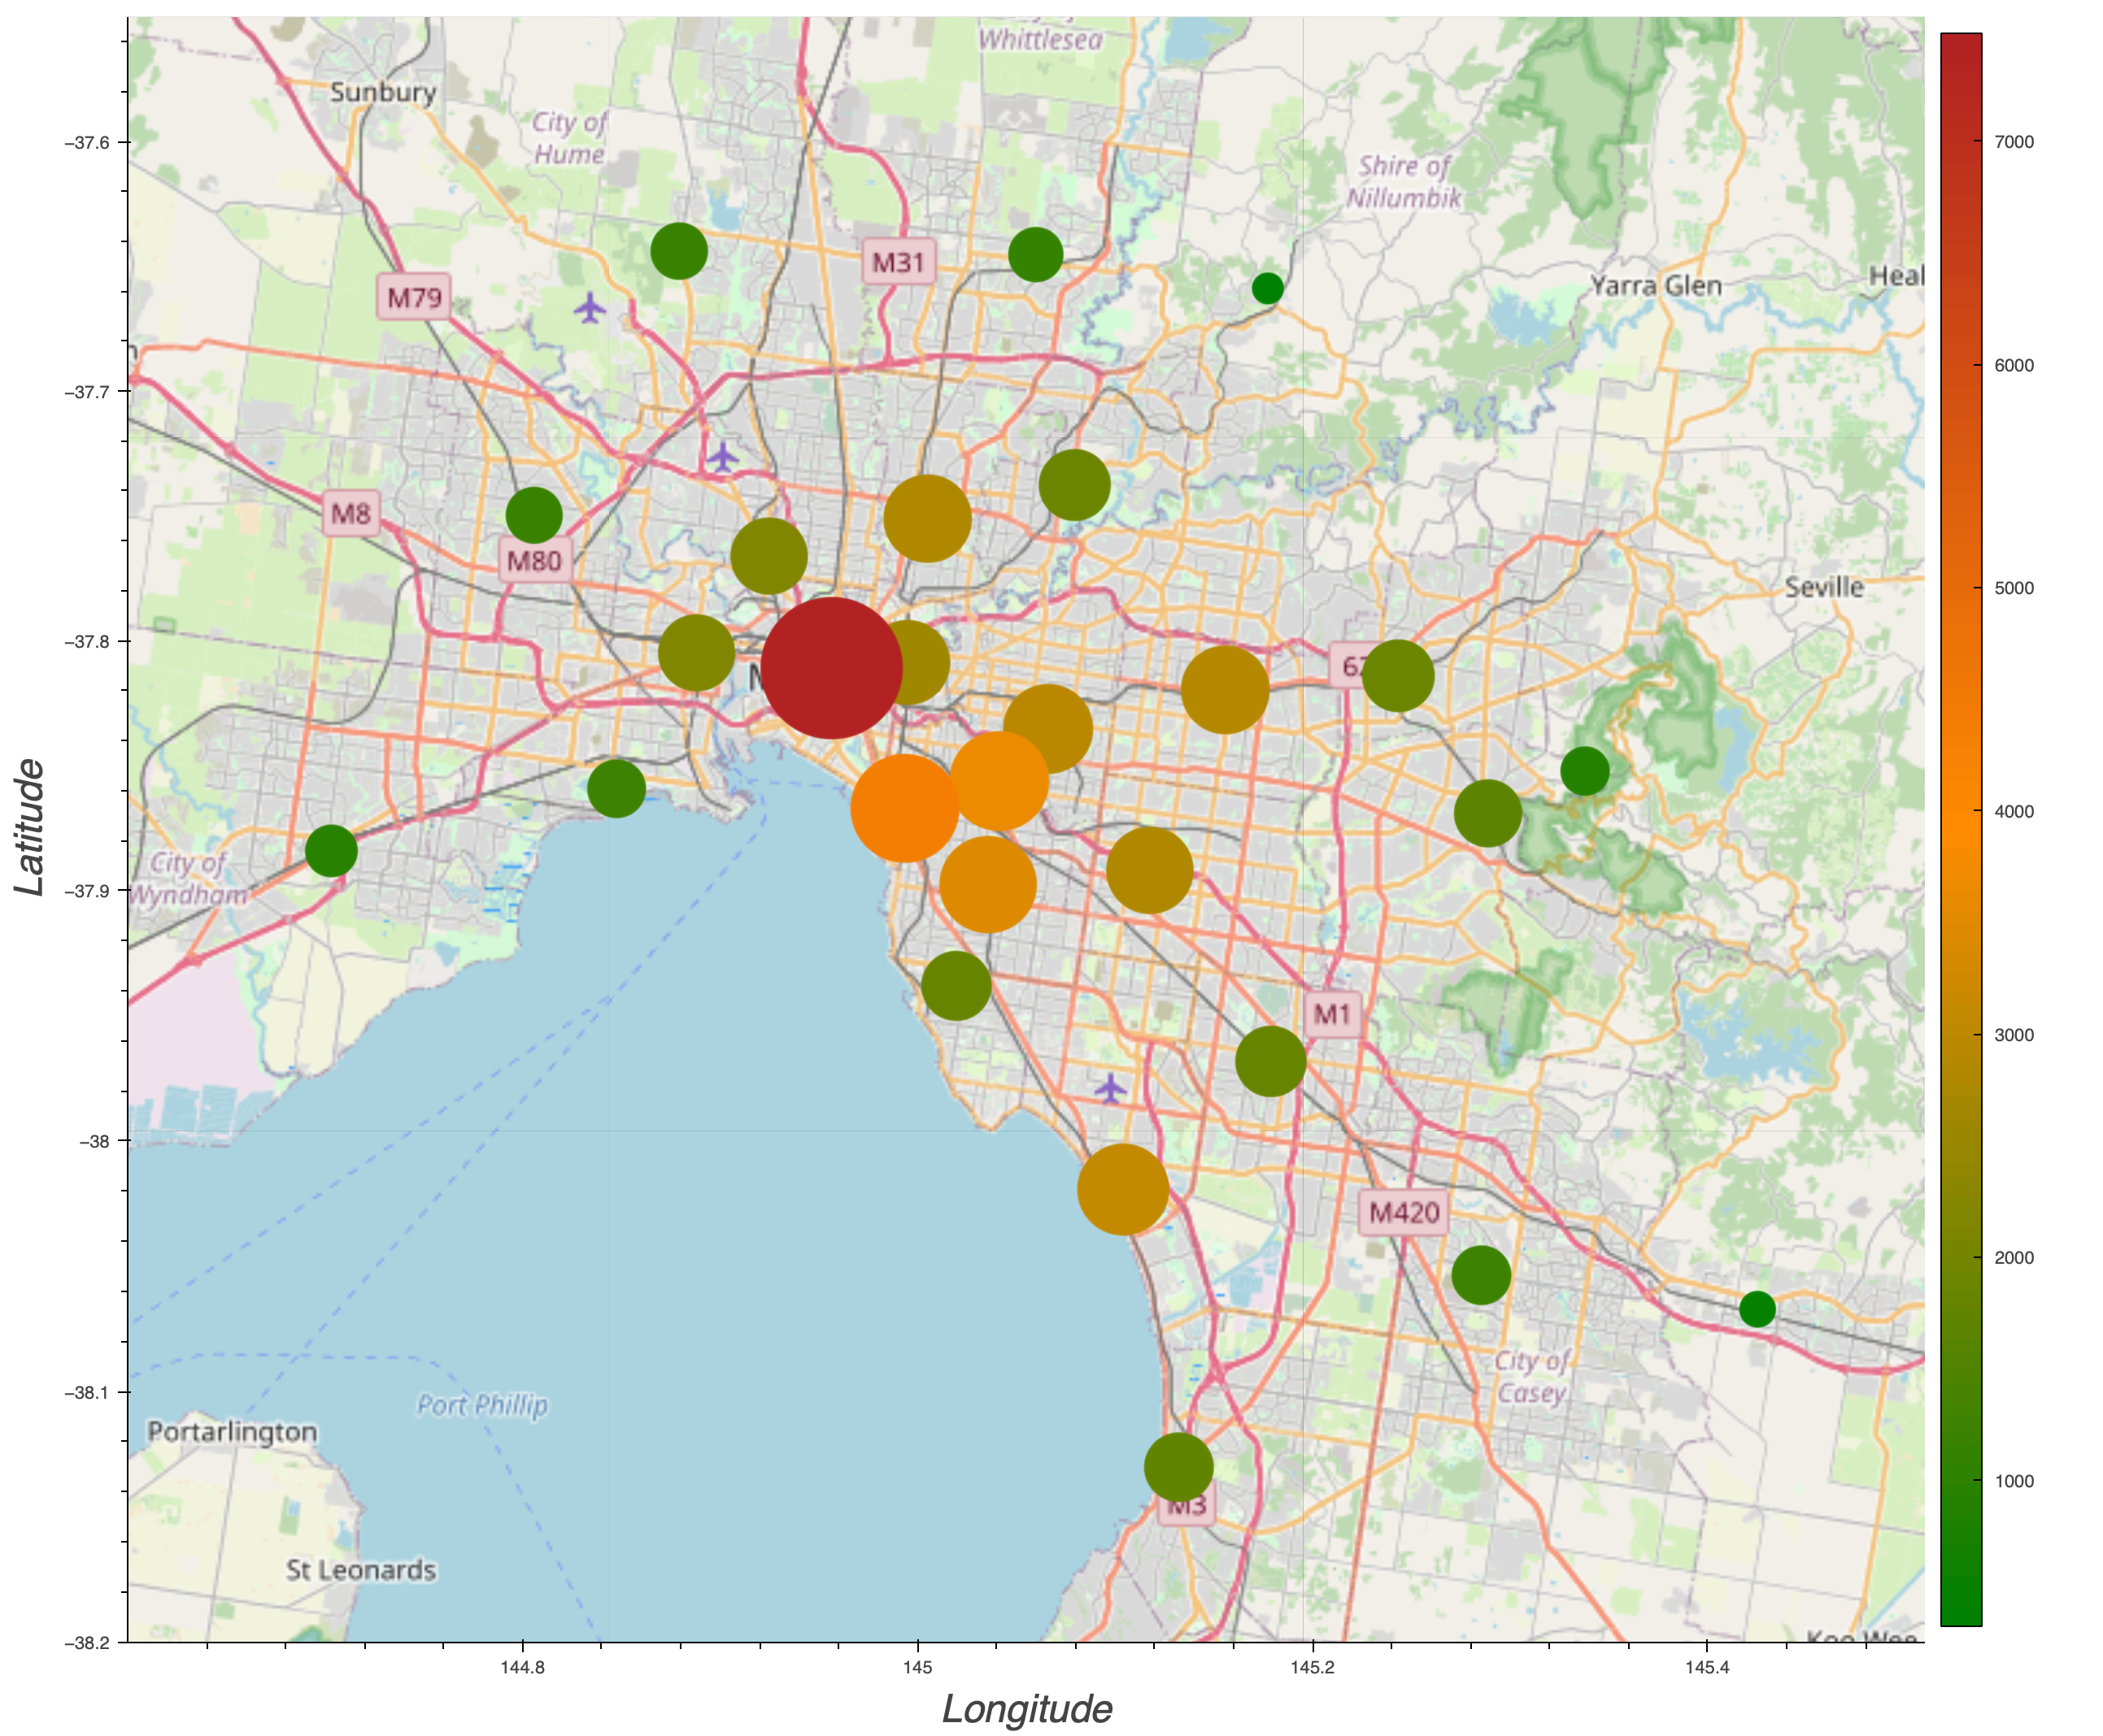
Apartments
/ Units Sell -
By Councils

Slide 9
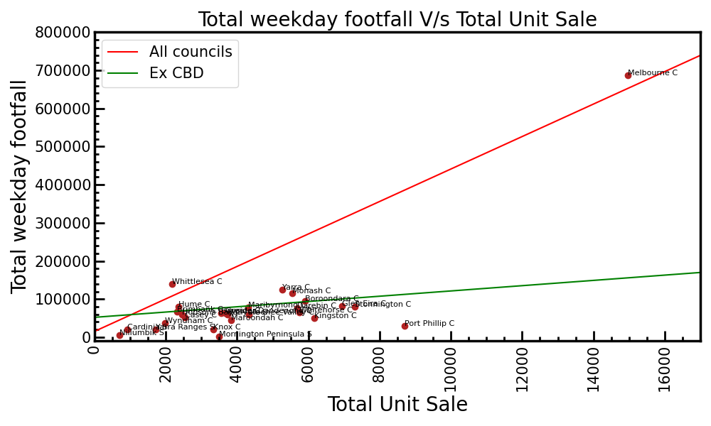
Correlation between footfall & total unit sale

Slide 10
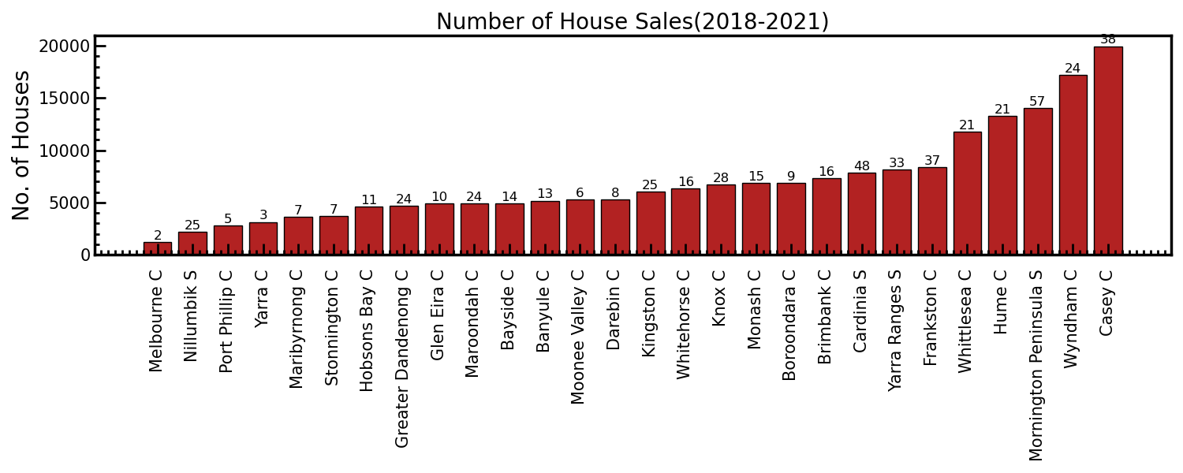
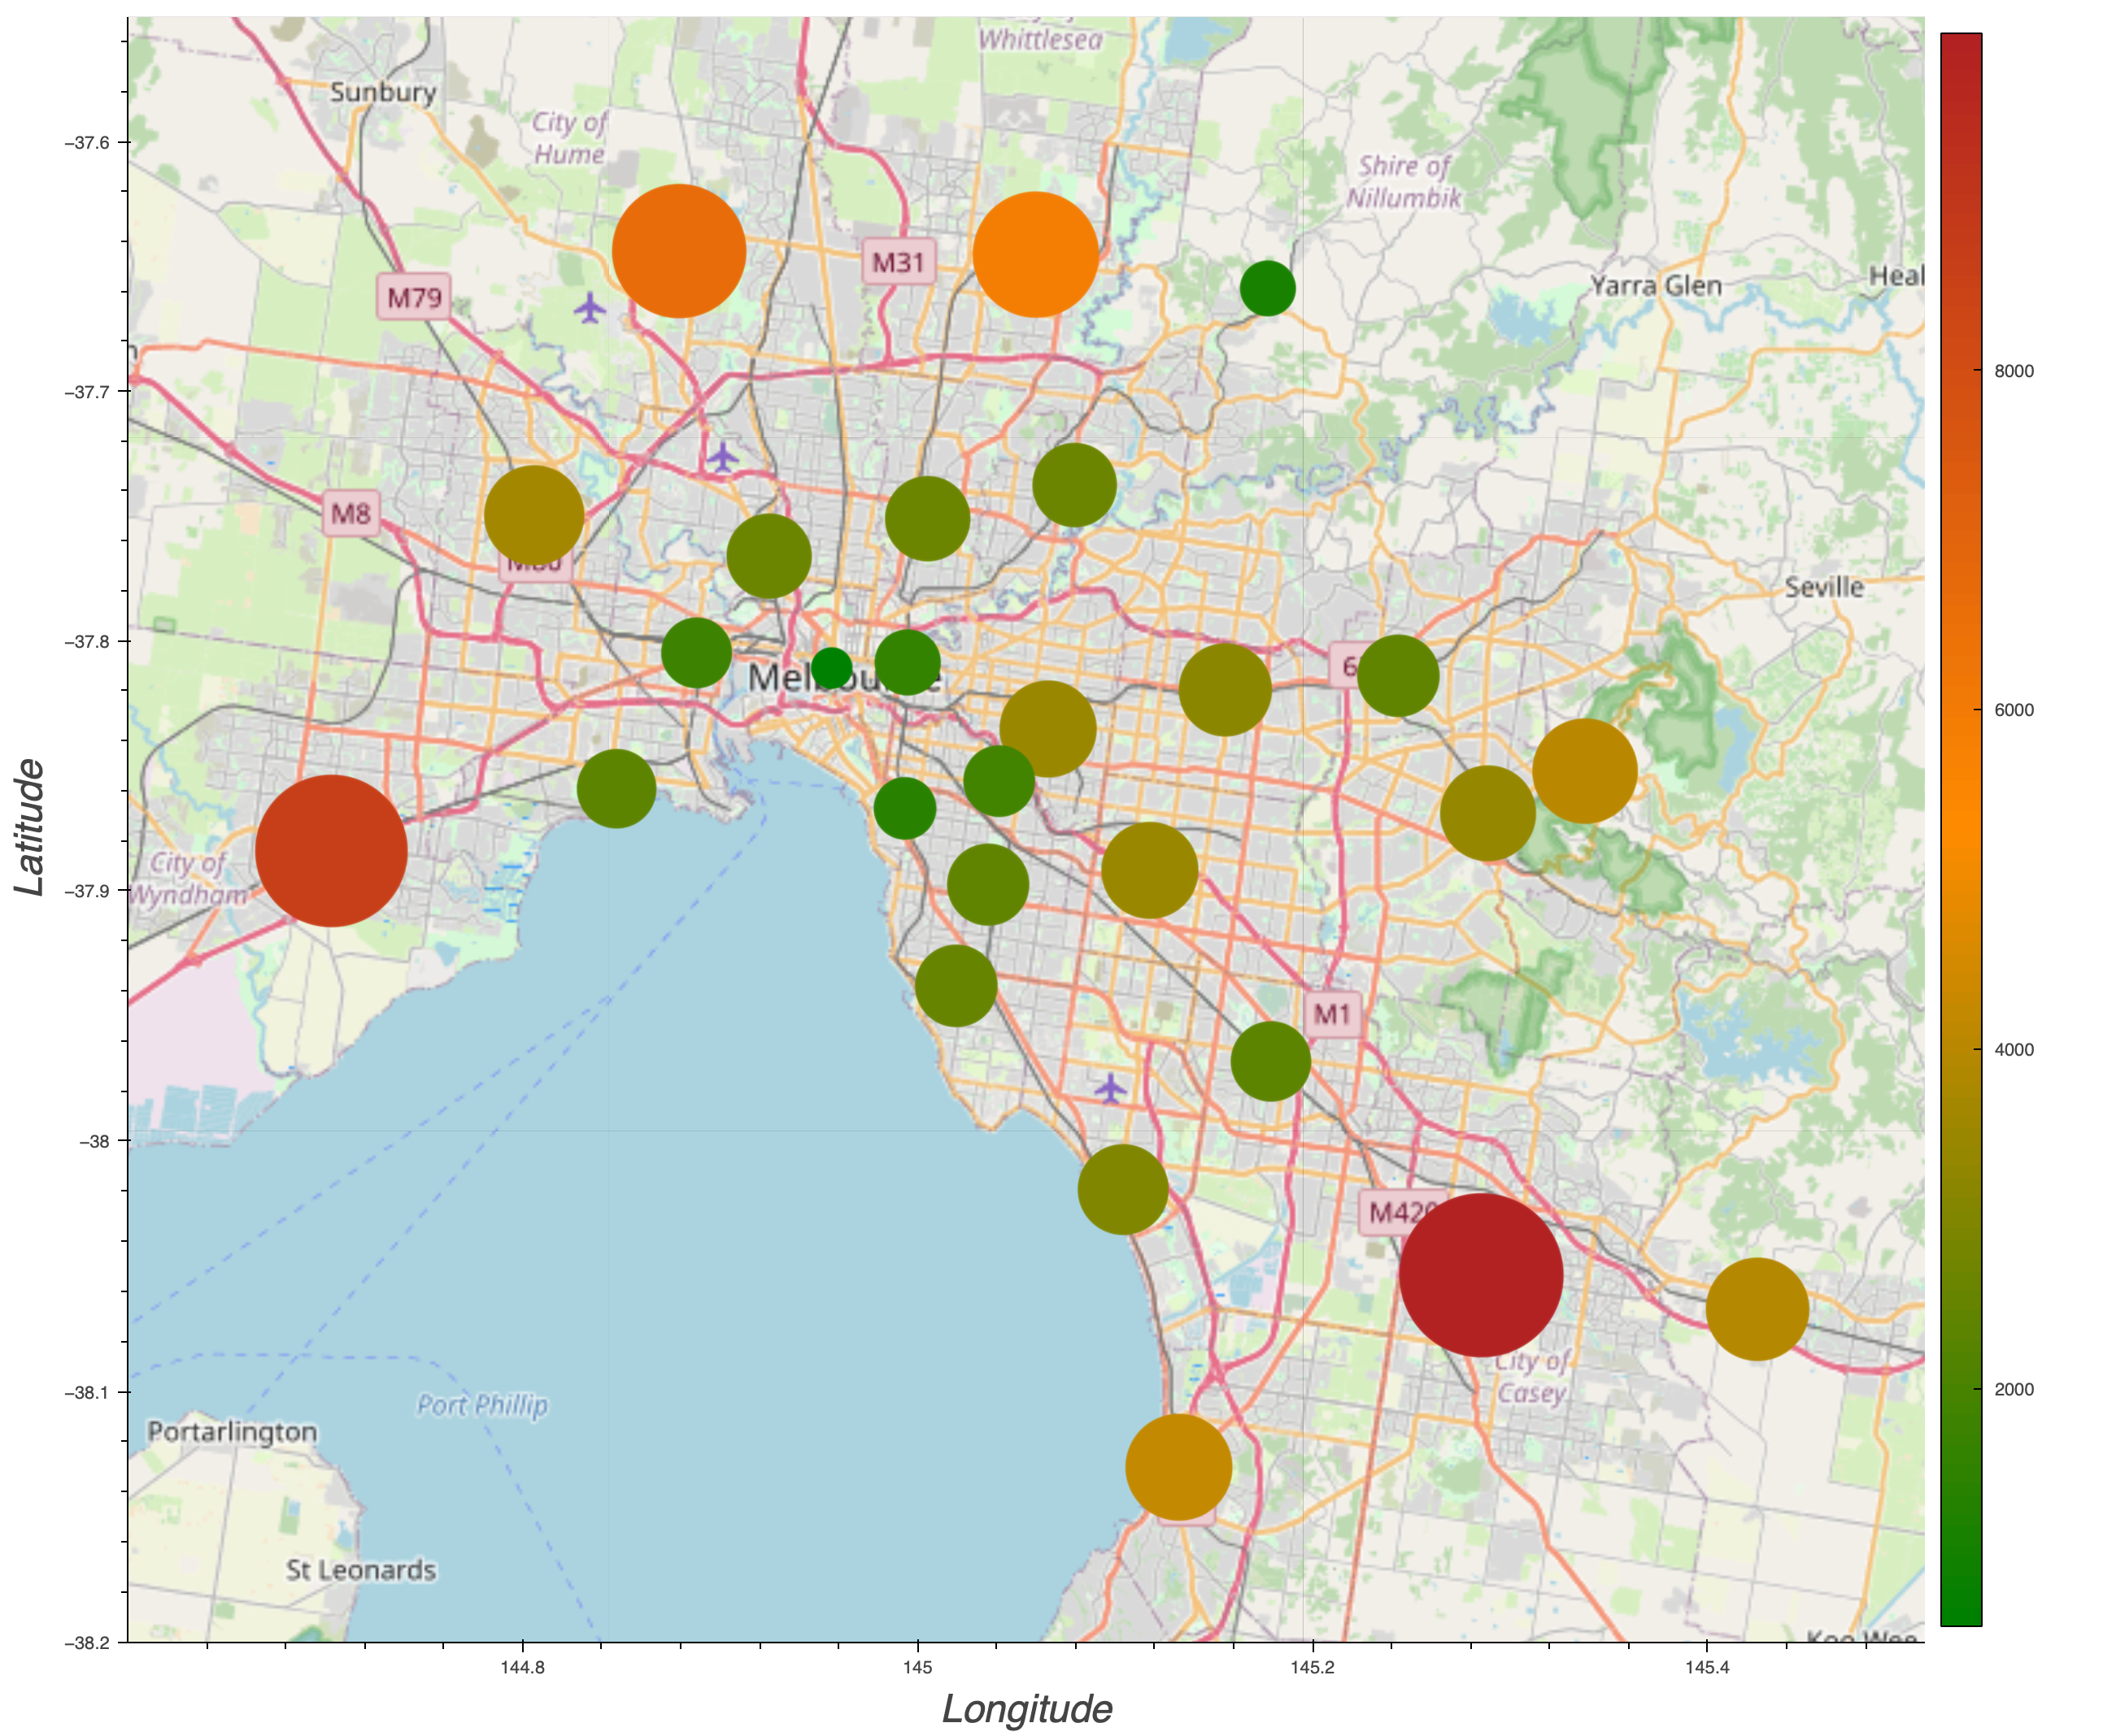
House Sell -
By Councils

Slide 11
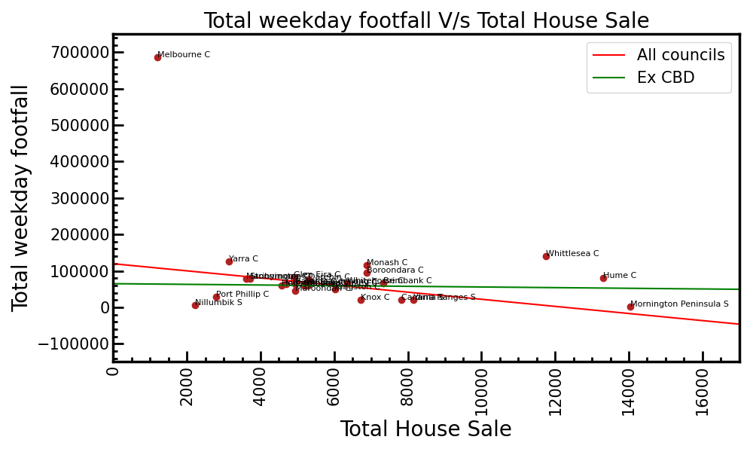
Correlation between footfall & total house sale

Slide 12
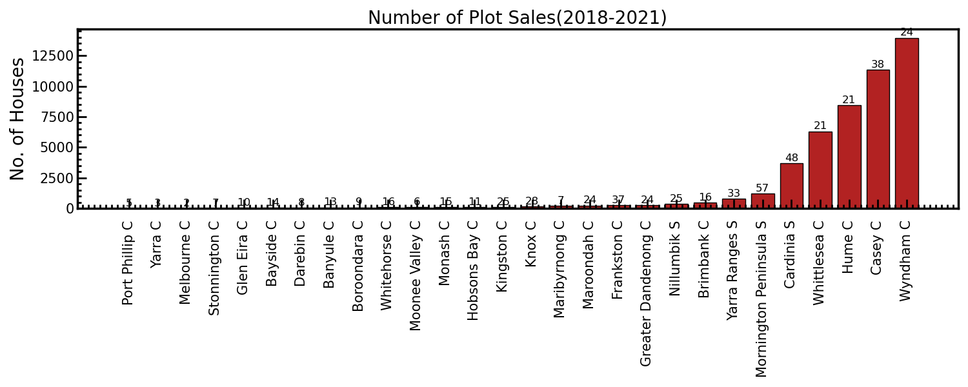
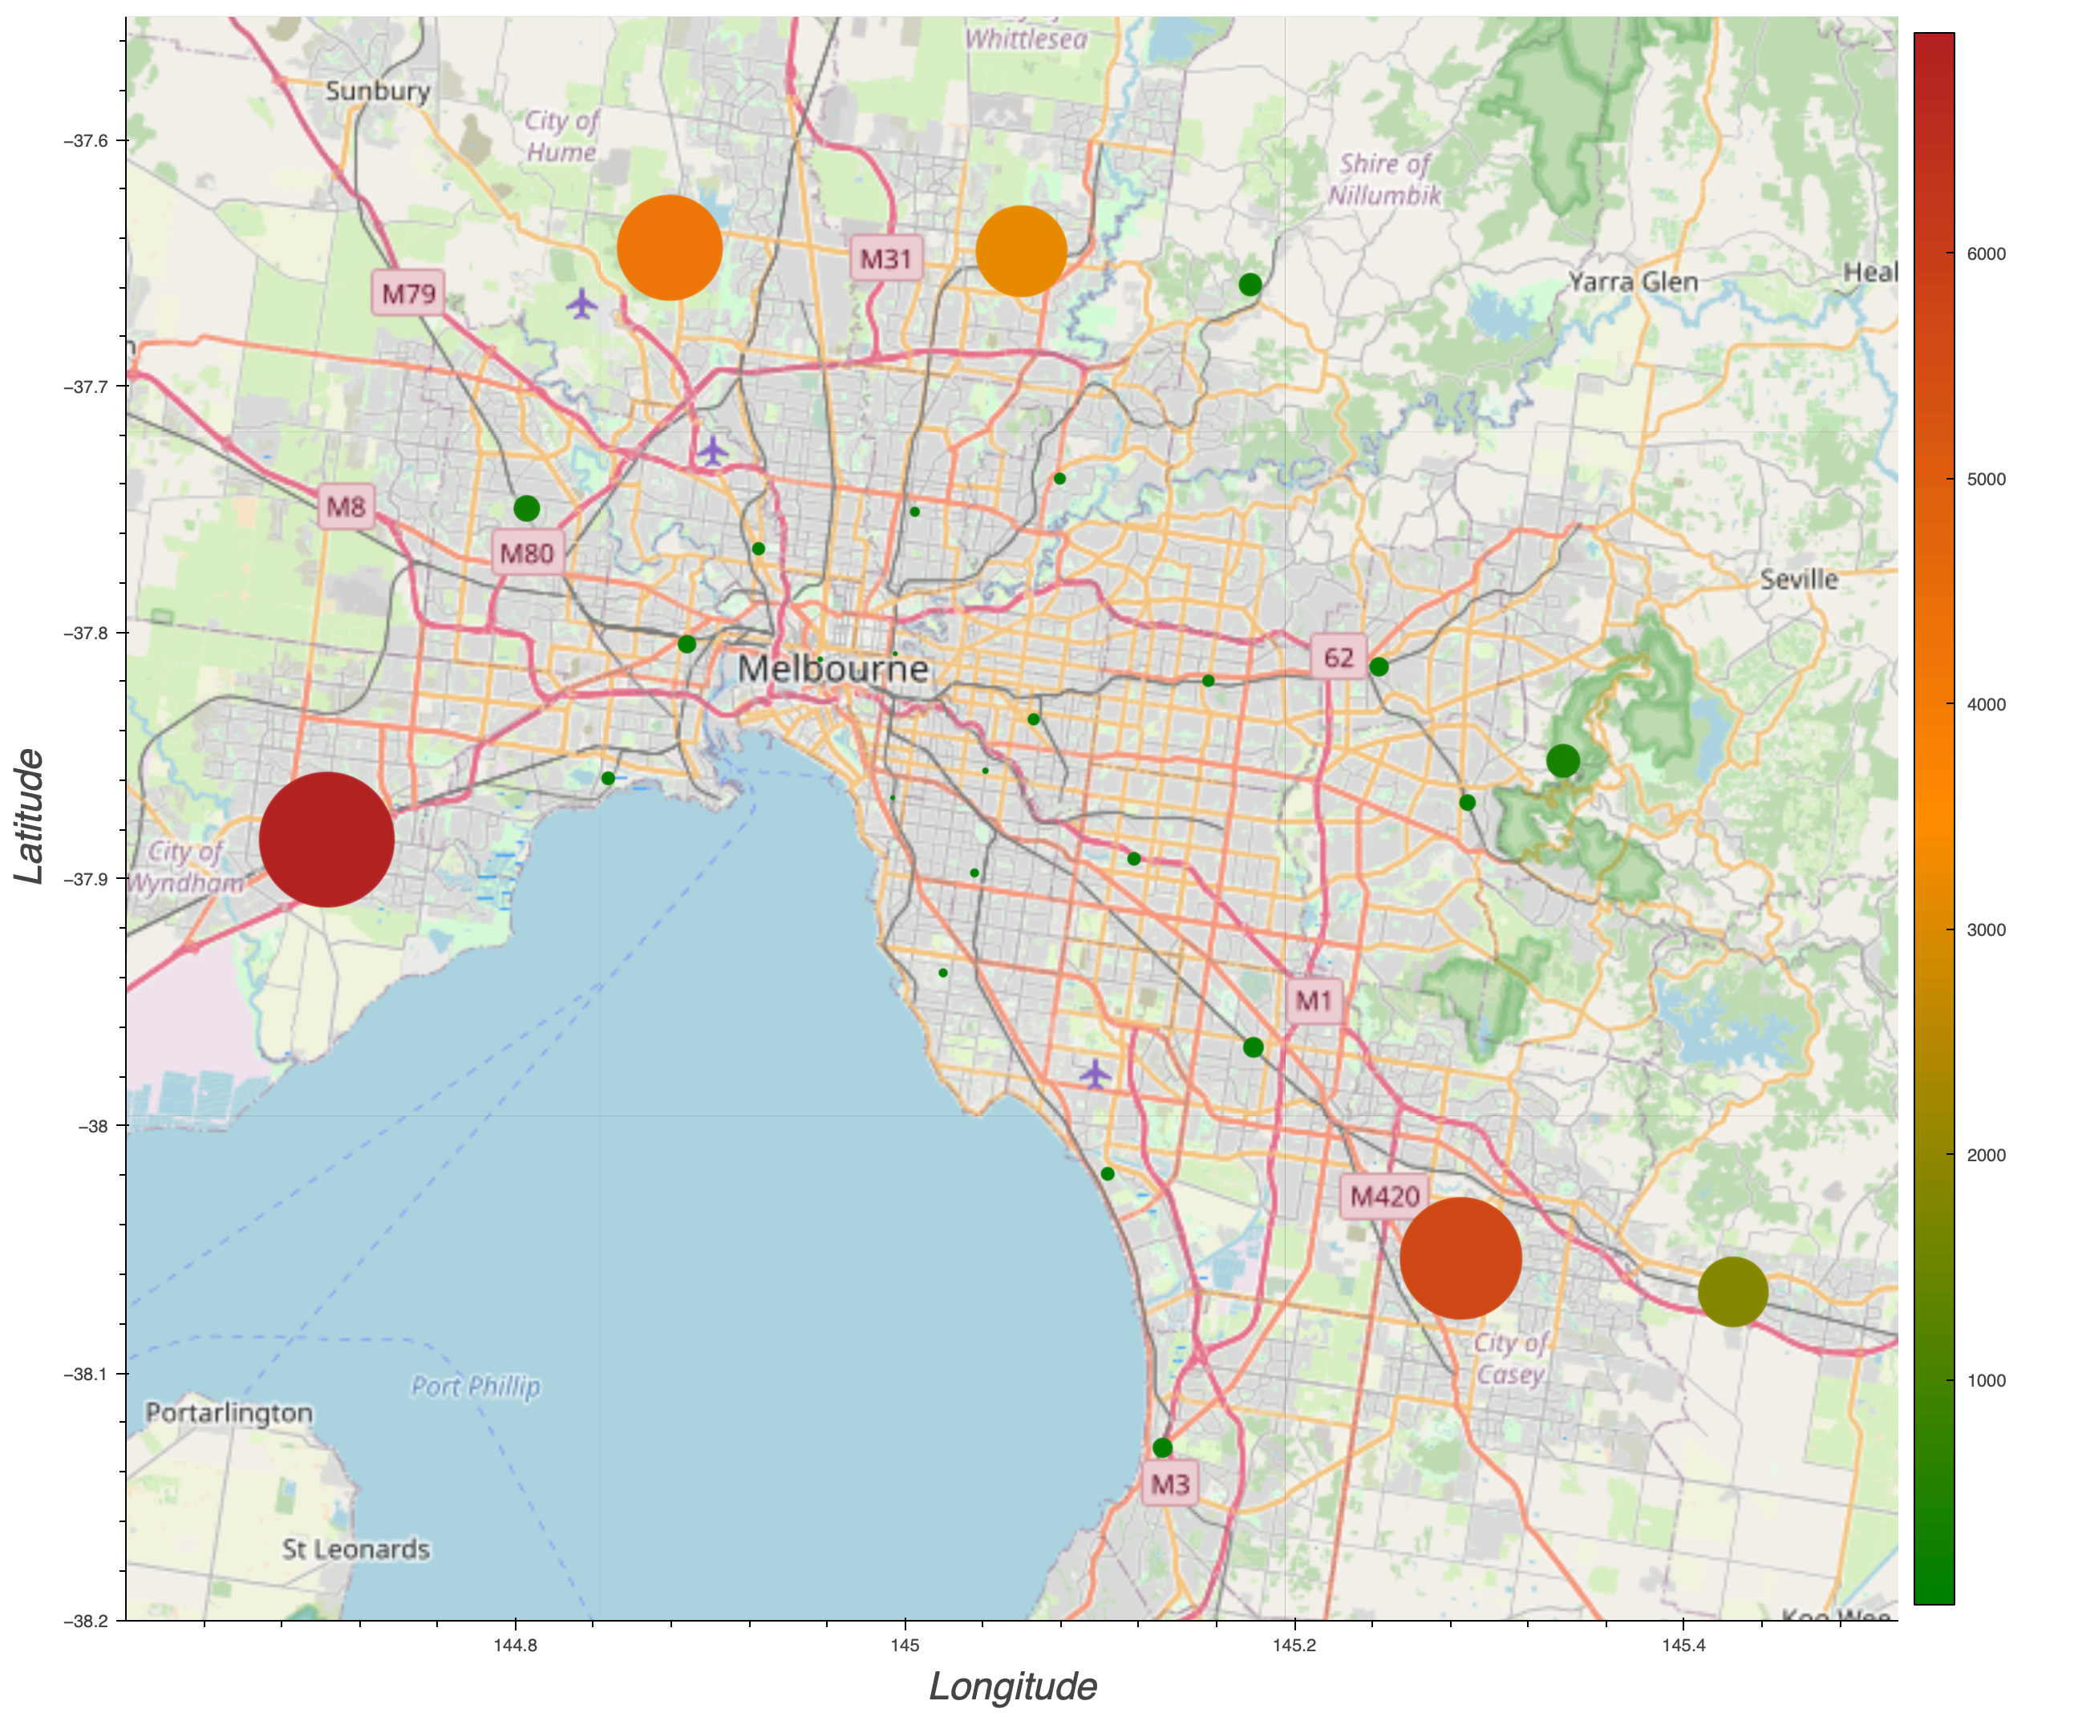
Plot Sell -
By Councils

Slide 13
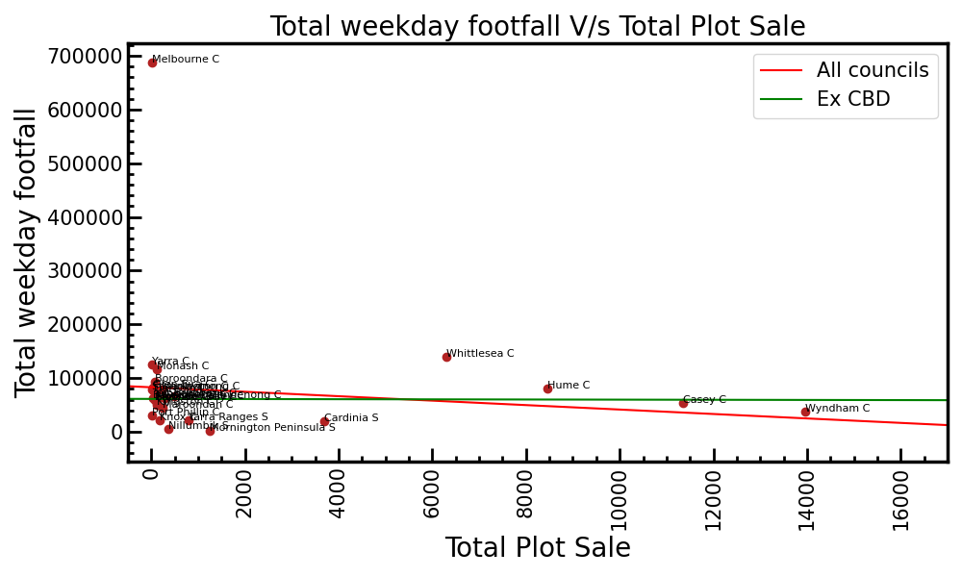
Correlation between footfall & total plot sale

Slide 14
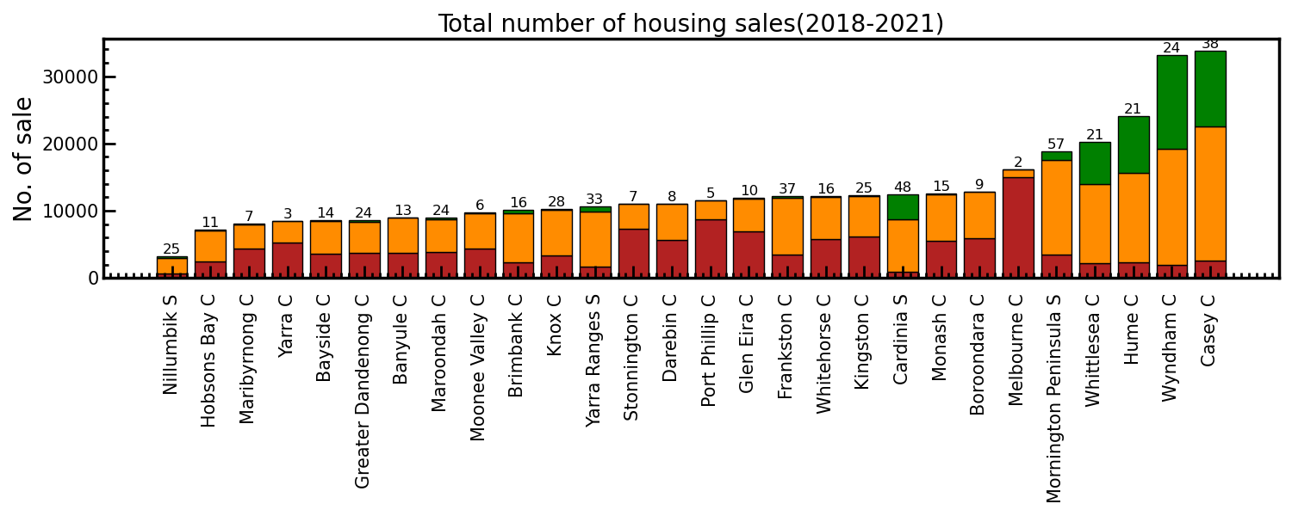
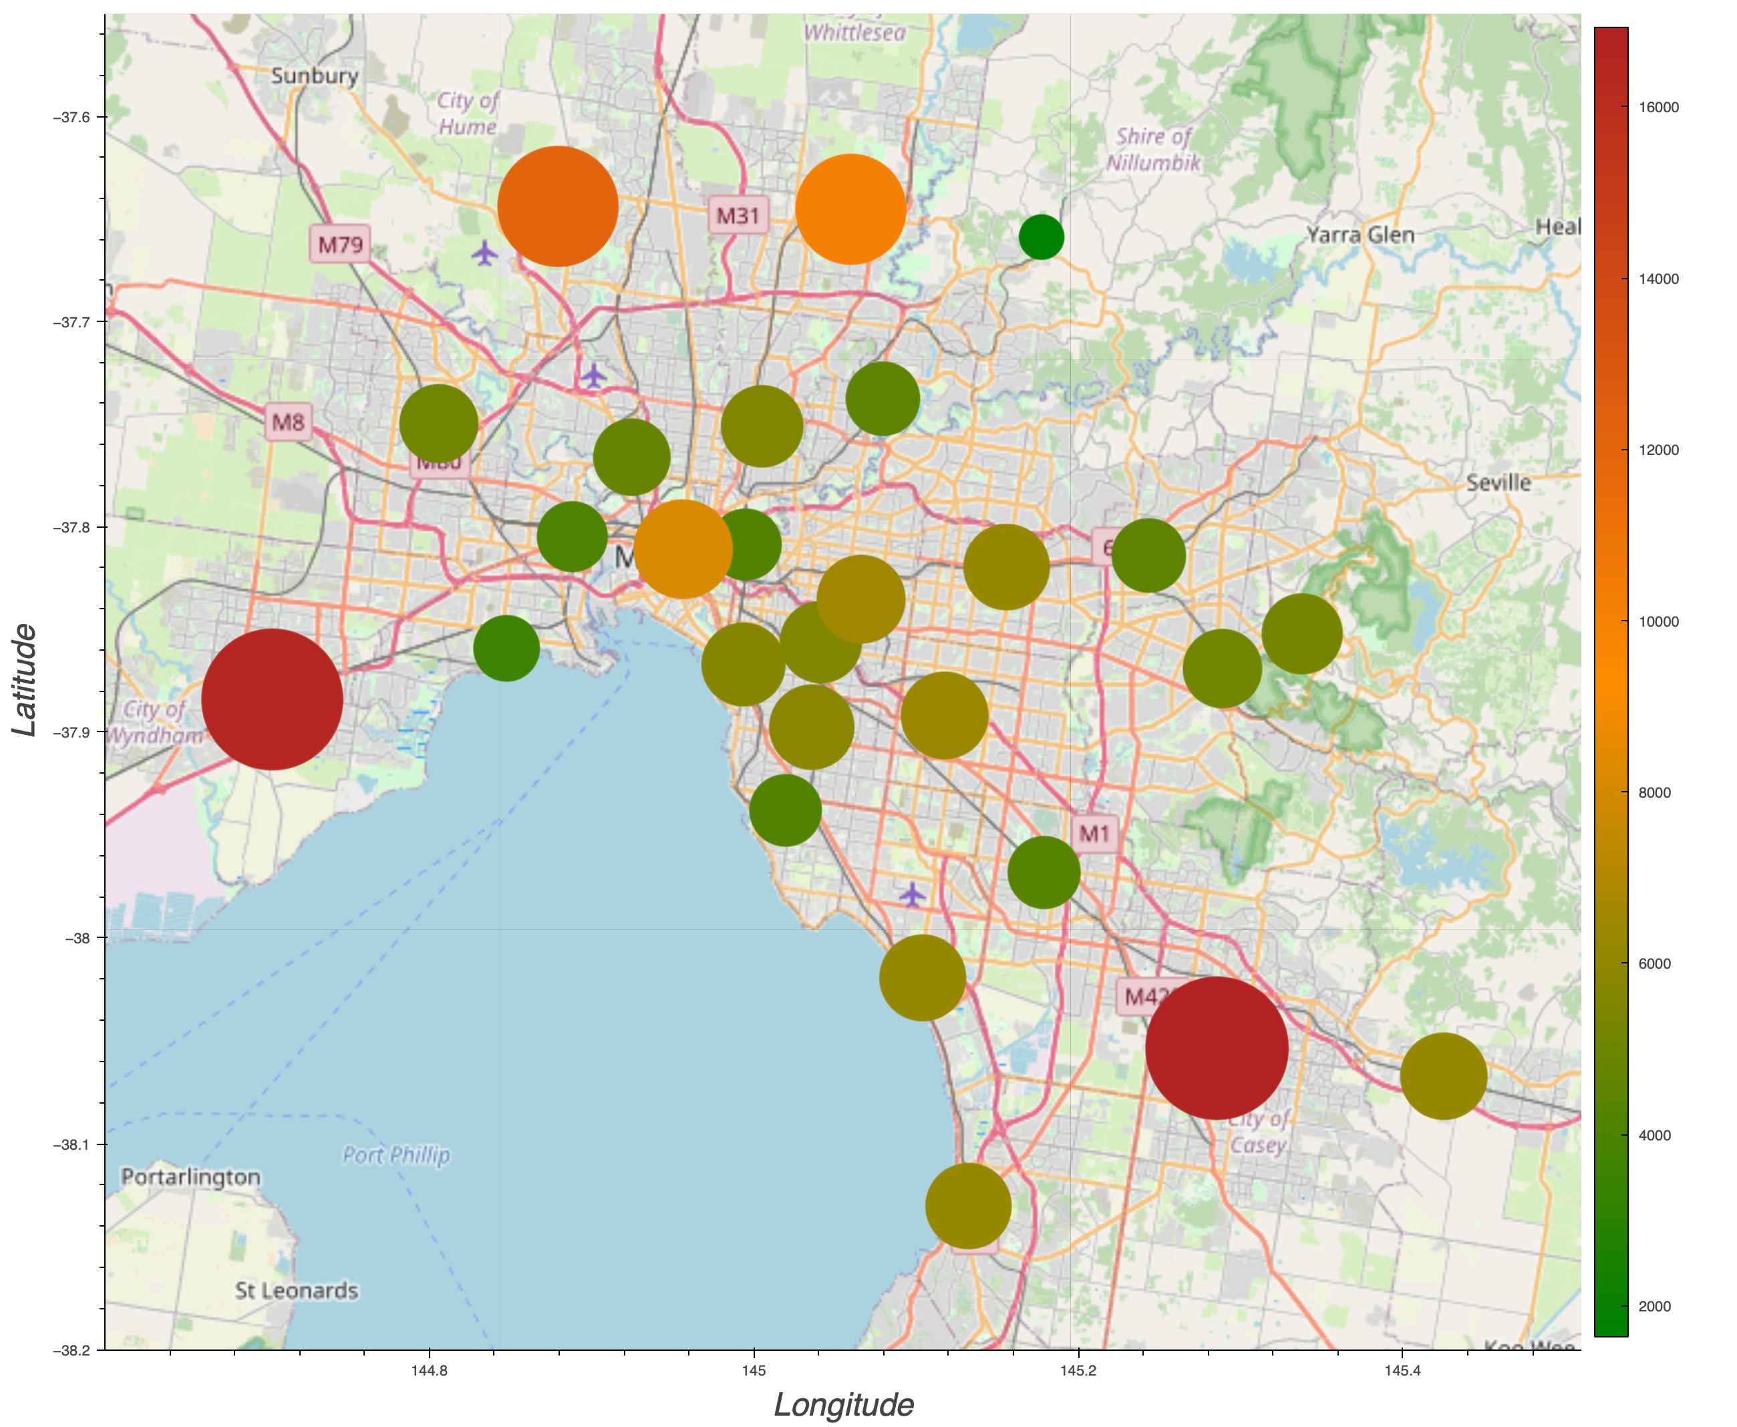
Total Sell -
By Councils

Slide 15
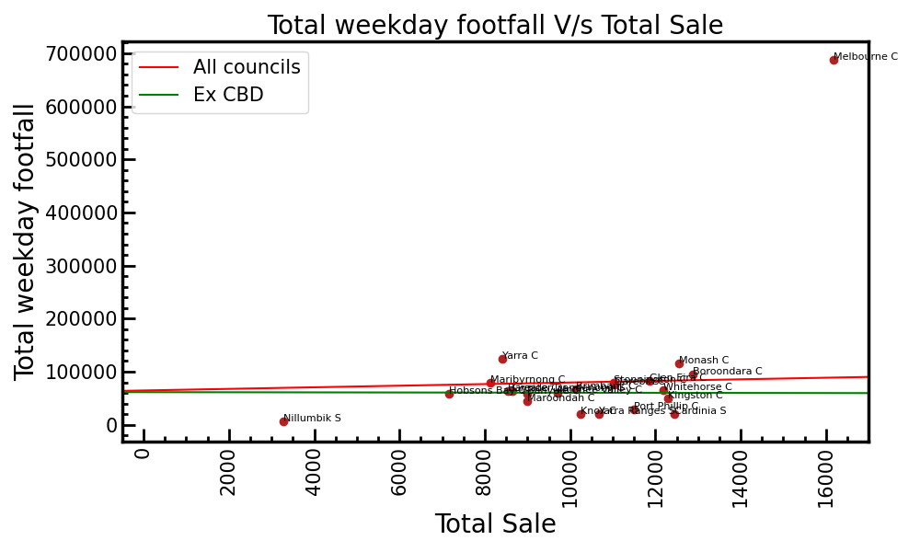
Correlation between footfall & total housing sale

Slide 16
Summary
The passenger footfall is significantly higher for CBD & surrounding councils due to presence of offices and tourist spots.
PTV data is line with VISTA, however number differs as VISTA is resident oriented survey
The apartments/units sell is higher for councils closer to CBD while plot sell is higher for councils away from CBD and vice versa.
We observe no correlation between passenger footfall and housing sell
Future prospects :
A similar research can be conducted for each suburb with/without census data for more detailed understanding the city growth.
The passenger footfall data along with PTV timetable can be studied to analyze growth for each metro line which can be helpful to improvise PTV timetable in future.
Thank You !

Slide 17
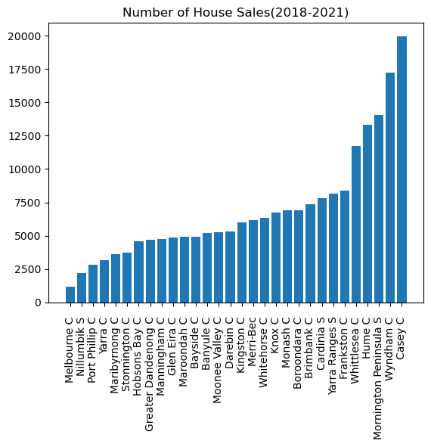
Housing sell – House
by City Councils

Slide 18
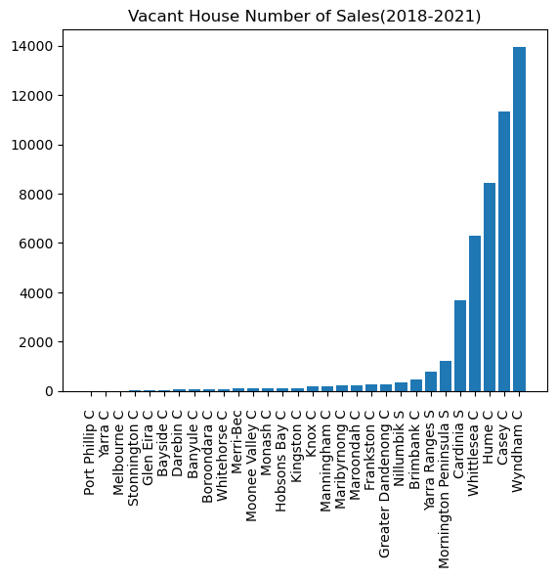
Housing sell – Plots
by City Councils

Slide 19
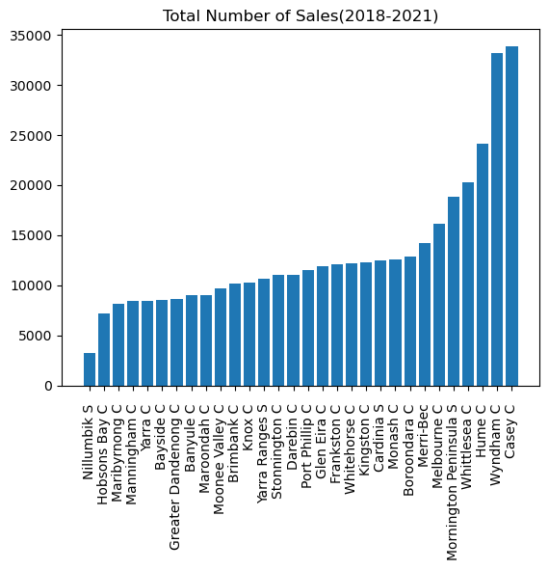
Housing sell – Total
by City Councils

Slide 20
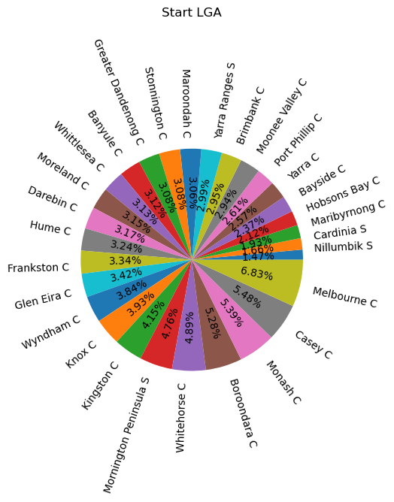

Appendix

